Slide 1
Mining argumentative attack-support relations through discourse markers
and adversarial training

Slide 2
Task description
claim
statement
result
drunk driving is wrong
drunk driving hurts innocent people
support
drunk driving is wrong
we should increase the limit of the blood alcohol level, since we have seen that people are capable of driving up to a certain level
attack
drunk driving is wrong
yesterday a drunk driver crashed into a tree
?

Slide 3
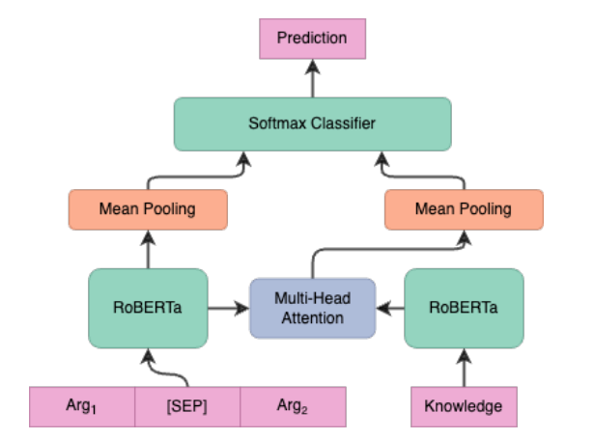
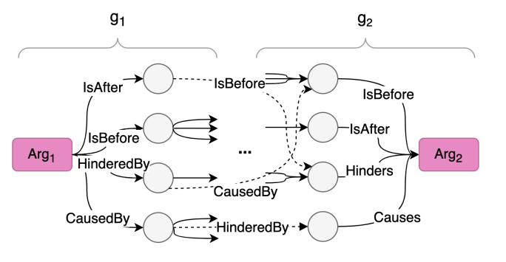
Previous work - ARGCON (https://aclanthology.org/2023.eacl-main.182.pdf)
main architecture
how “knowledge” is obtained
They use COMET (T5 model) to generate relations isAfter, isBefore, HinderedBy, CausedBy. These relations are then verbalized and fed to the main architecture.
e.g. Arg1 isAfter “blahblah” CausedBy Arg2

Slide 4
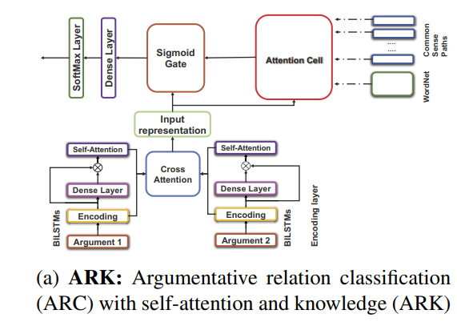
Previous work - ARK (https://www.cs.toronto.edu/pub/gh/Paul-etal-COMMA-2020.pdf)
They use BILSTMs and Cross Attention for the input representation and extract knowledge from WordNet and ConceptNet as “common sense knowledge”

Slide 5
Previous work - LogBERT (https://aclanthology.org/2021.tacl-1.44.pdf)
textual entailment
2 datasets: MNLI and AntSyn
sentiment coherence
5 datasets: SemEval17, entities, opendomain, IrishPolitics, custom dataset
They finetune BERT models on these datasets
causality classification
4 datasets: PDTB 3.0, BECauSE 2.0, WIQA, ConceptNet
normative relation classification custom dataset

Slide 6
Discourse markers (Fraser et al. https://www.sciencedirect.com/science/article/pii/S0378216698001015)
“I have defined DMs as a pragmatic class, lexical expressions drawn from the syntactic classes of conjunctions, adverbials, and prepositional phrases. With certain exceptions, they signal a relationship between the segment they introduce, S2, and the prior segment, S1”
contrastive markers
We left late. Nevertheless, we got there on time.
inferential markers
There's a fearful storm brewing. So don't go out
elaborative markers
You should always be polite. Above all, you shouldn't belch at the table.
…
…

Slide 7
Research questions
Can discourse markers effectively distinguish between attack and support statements in a given claim-statement pair?
Do specific categories of discourse markers (e.g., contrastive, inferential and elaborative markers) have a significant impact on the accuracy of attack/support detection?
How do the embeddings of the different datasets relate to each other? E.g. are contrastive relations closer to attack statements?
How do the distributions and functions of discourse markers differ between attack and support statements, and can these differences be exploited to enhance argument mining models?

Slide 8
Dataset
student essay
samples train: 3070
samples dev: 1142
samples test: 1100
Discovery (https://github.com/sileod/Discovery)
samples train: 1.57M
samples dev: 87k
samples test: 87k
Debatepedia
samples train: 6486
samples dev: 2163
samples test: 2162

Slide 9
Preprocessing dataset
We take the discourse marker classification of Fraser et al., discarding all the discourse markers that are classification targets in Discovery, but are not present in Fraser’s classification.
Then, we map each word into its discourse marker type, turning the dataset from 147 target classes to 3 target classes.
The resulting dataset has:
samples train: 341K
Discovery (https://github.com/sileod/Discovery)
samples train: 1.57M
samples dev: 87k
samples test: 87k

Slide 10
h_{<s>}
Linear
. . . . . . . . . . . . . . . . . .
K
Linear
FC task dataset
y₁
RoBERTa
V
<s> sentence1 </s> sentence2 </s>
h_{</s>}
CrossAttention
FC discourse marker
y₂
Q
. . . . . . . . . . . . . . . . . .
Linear
h_{</s>}
Gradient Reversal Layer
Task FC
y₃
In forward, il GRL è una funzione identità, mentre in backward() cambia il segno del gradiente.
Task FC cerca di riconoscere da quale dataset proviene l’embedding. Con il GRL, cerchiamo di massimizzare l’errore di riconoscimento della provenienza
(Adversarial Training)

Slide 11
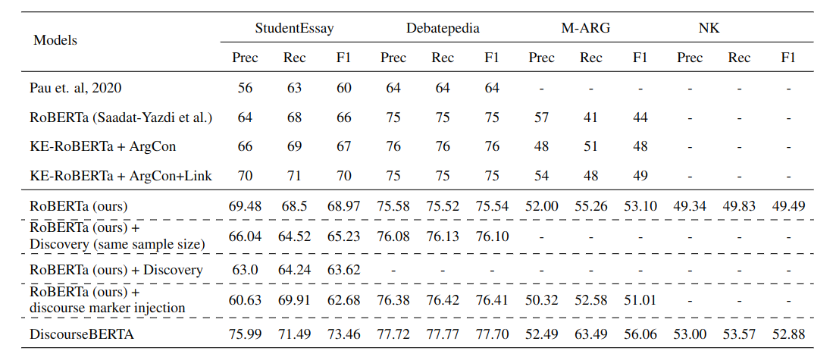
Results (so far)
?
?
?
?
?
?
?
?
?
?
?
?

Slide 12
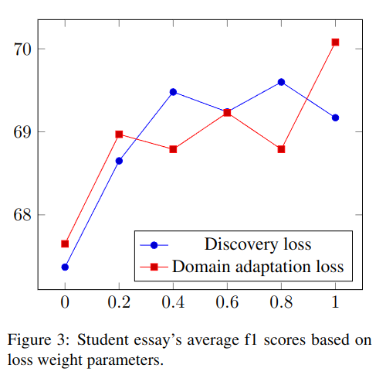
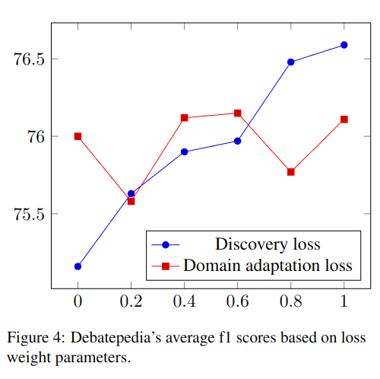
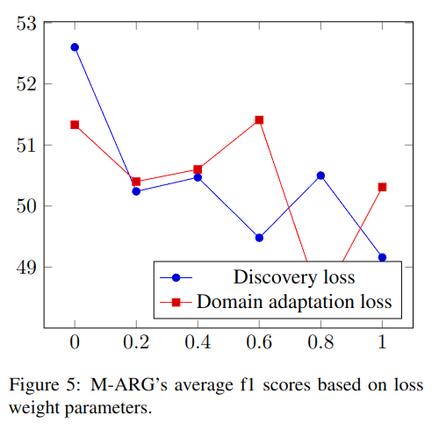
Results (so far)

Slide 13
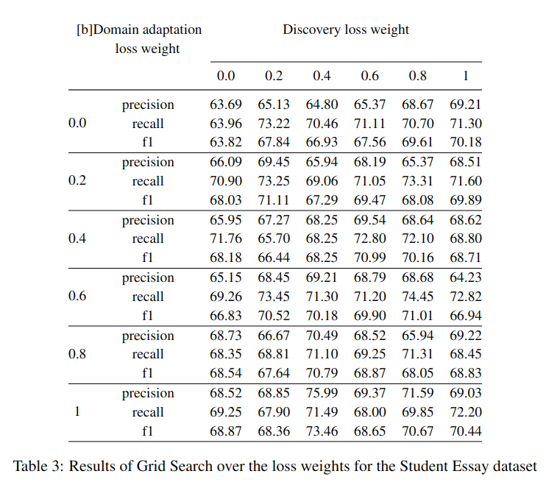
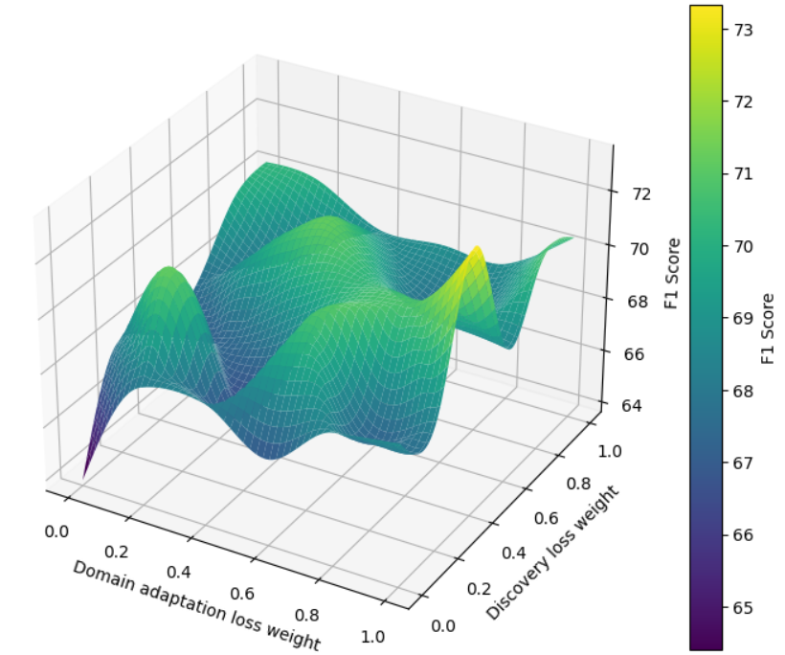
GridSearch over StudentEssay

Slide 14
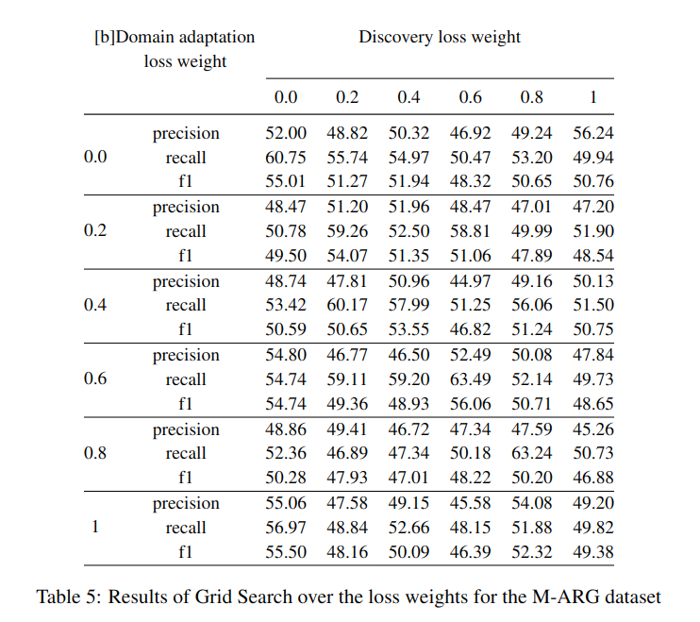
GridSearch over M-ARG

Slide 15
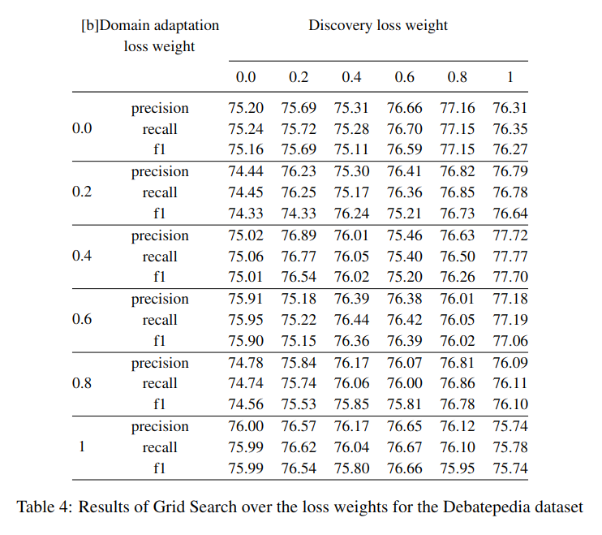
GridSearch over Debatepedia

Slide 16
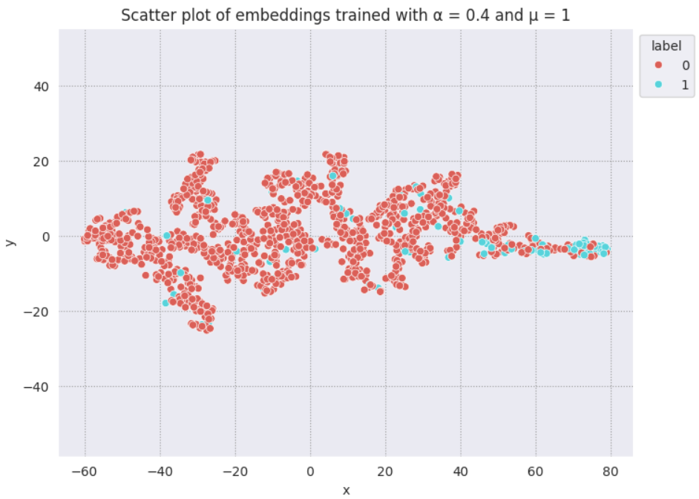
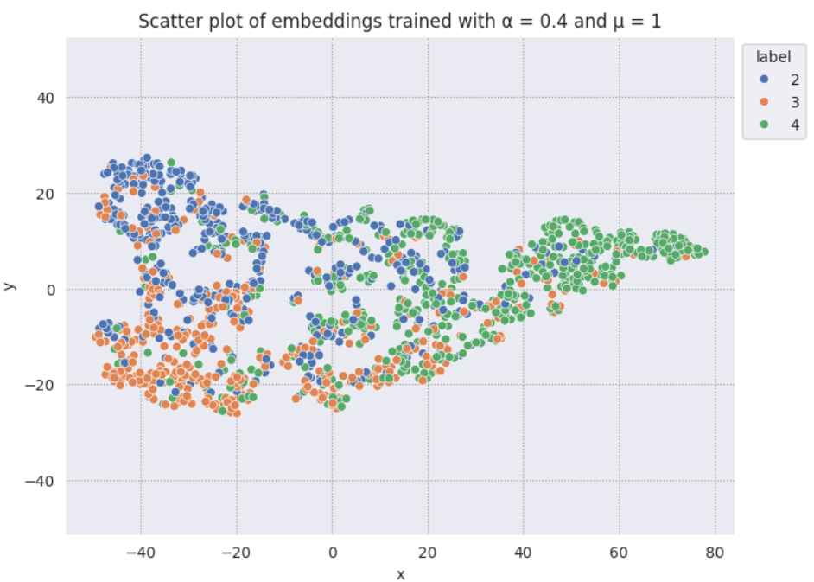
Scatterplot StudentEssay vs Discovery
Scatterplot StudentEssay
Scatterplot Discovery

Slide 17
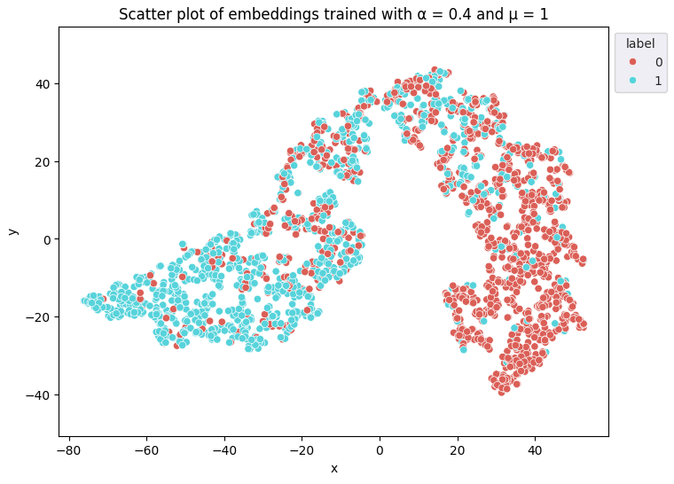
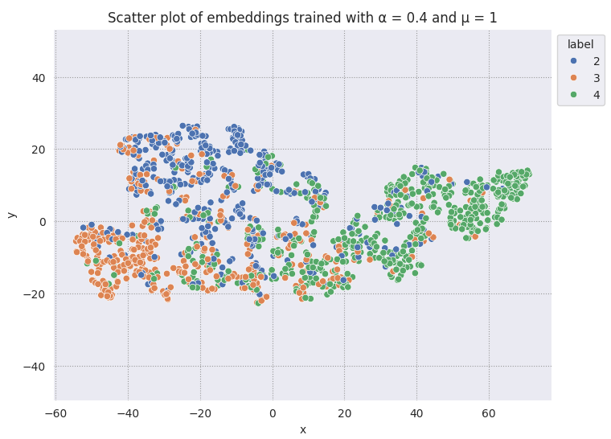
Scatterplot StudentEssay vs Discovery
Scatterplot Debatepedia
Scatterplot Discovery

Slide 18
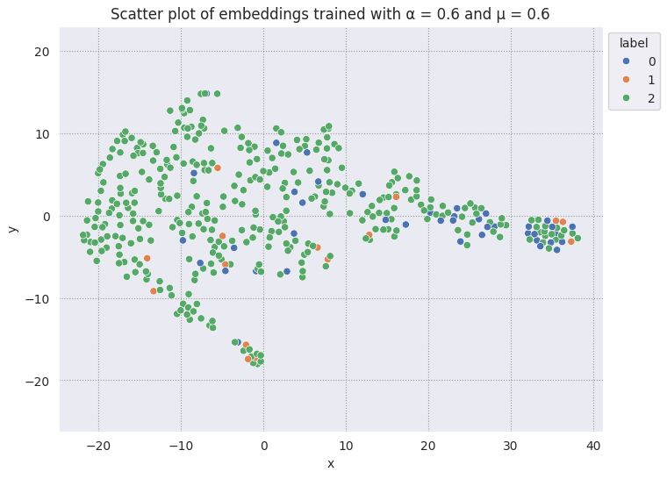
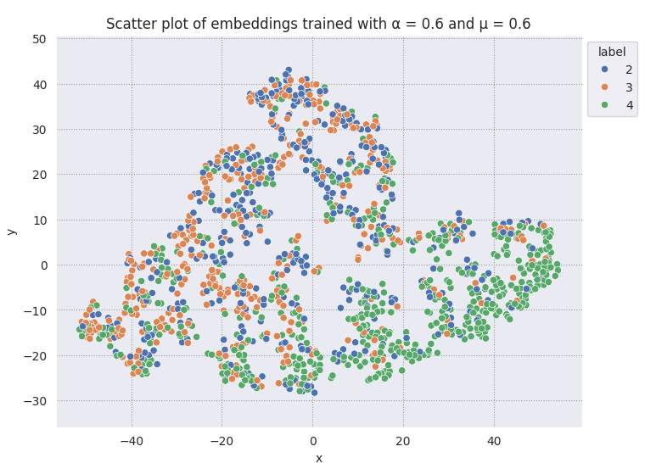
Scatterplot StudentEssay vs Discovery
Scatterplot M-ARG
Scatterplot Discovery

Slide 19
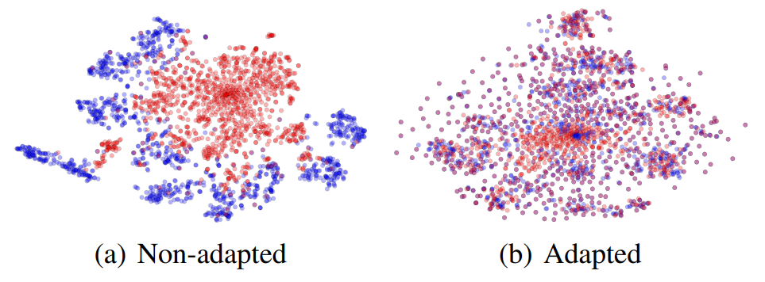
What I want to achieve in the analysis
GRL pushes the embedding on the same latent space.
It may be interesting to do a clustering analysis and see how much the different classes in the two datasets relate to each other
taken from GRL’s paper
a study on the distribution of different discourse markers
ablation studies on the effect of adversarial training on argument relations

Slide 20
05/06/2024

Slide 21
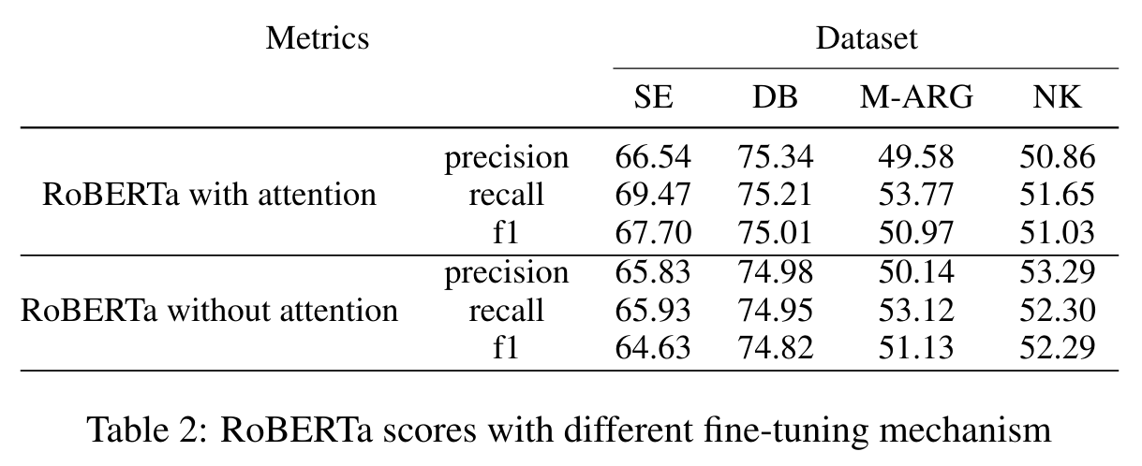
Results (so far)

Slide 22
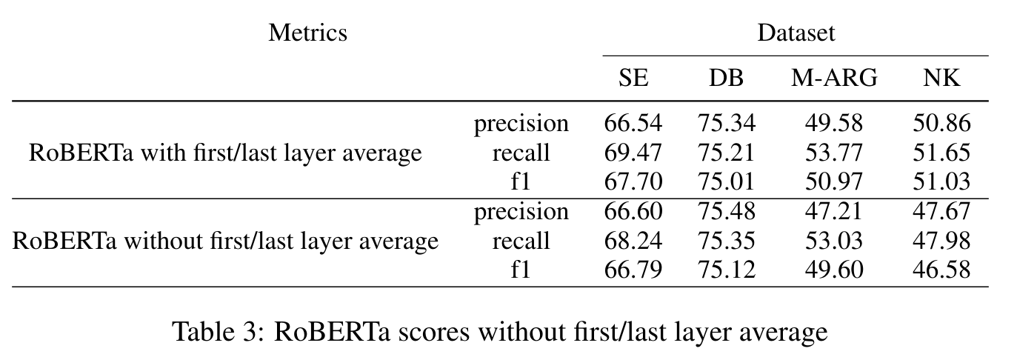
Results (so far)

Slide 23
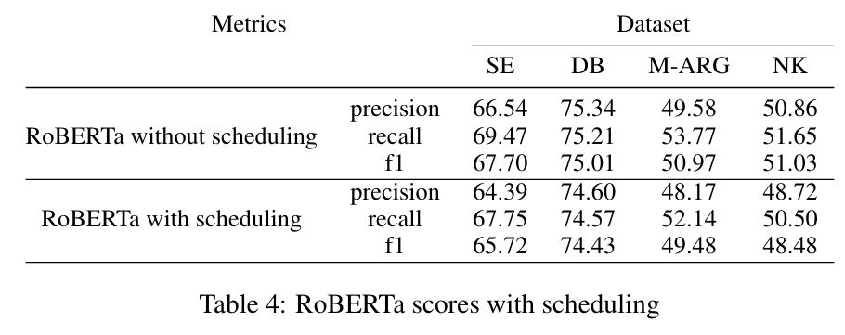
Results (so far)

Slide 24
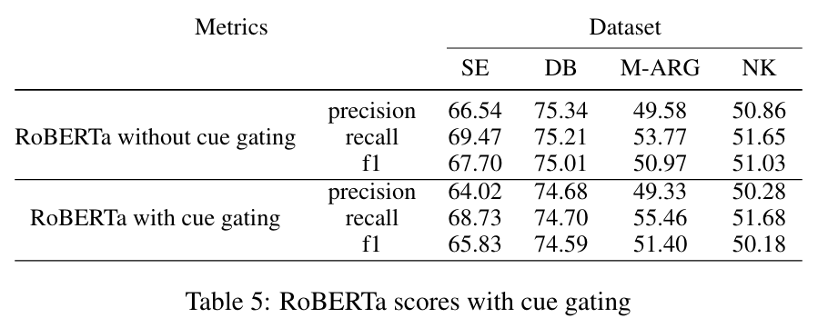
Results (so far)

Slide 25
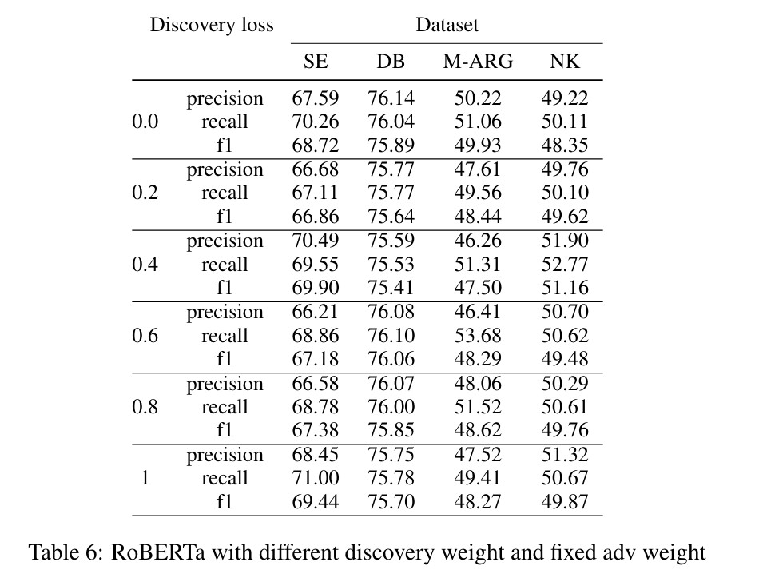
Results (so far)

Slide 26
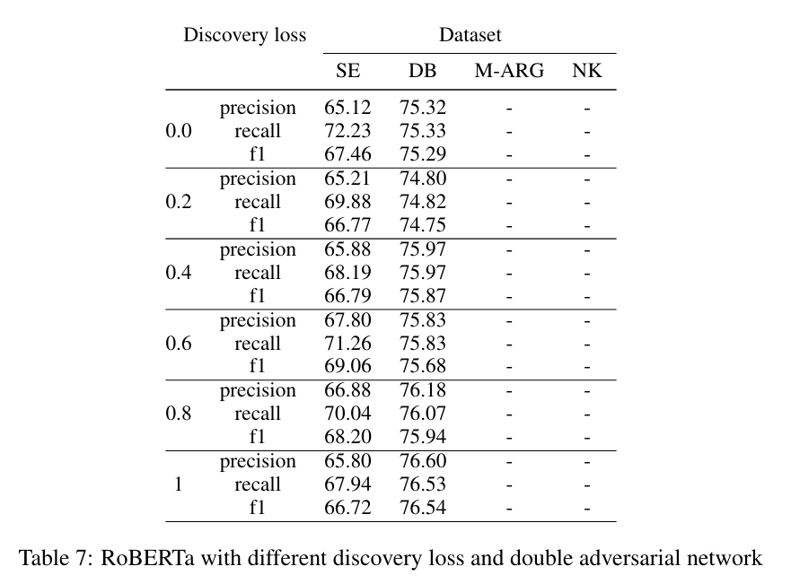
Results (so far)

